Slide 1
PRODUCT REVENUE ANALYSIS
Name: Geetanjally
Roll no: 12200821
Stream: B.tech CSE

Slide 2
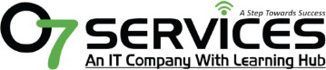
Certification: ISO 9001:2015 Certified
Specializations:
Web Development
Mobile Application Development
Custom Software Development
UI/UX Design
Hosting Services
Digital Marketing
Services:
Advanced IT solutions supporting the entire business
Consulting to system development
Deployment
Quality Assurance
24x7 Support
Company
Profile
Headquarters: Jalandhar
Branch Office: Hoshiarpur

Slide 3

Company Name: O7 Solutions IT Company Founded: 2017
Certification: ISO 9001:2015 Certified Specializations:
Mobile Development
Web Development
Software Development
Digital Marketing
IT Integration
Experience: Over 7 years
Company Profile

Slide 4
Table of Content
Introduction
Technology Used
Python Libraries
Goals and objectives
DFDs
Requirements Screenshots Conclusion
Future scope
Thankyou

Slide 5

INTRODUCTION
This project is a beginner-friendly Data Science case study focused on analyzing sales performance and product revenue using real-world e-commerce data. The goal is to identify which products or categories generate the most revenue and profit, analyze sales trends over time, and visualize key insights using interactive dashboards.

Slide 6
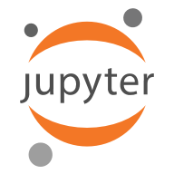
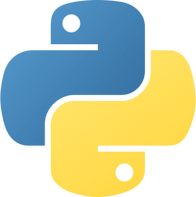



TECH USED
Python
JUPYTER LAB
Python being an object-oriented programming language. It has a very easy syntax despite being case-sensitive and interpreted. Indentation increases readability.
JupyterLab is an advanced, web-based interface for working with Jupyter Notebooks. It supports code, text, terminals, and data visualization in a flexible, multi-tab layout—ideal for data science and research.

Slide 7


PYTHON LIBRARIES
Pandas is a powerful open-source Python library used for data manipulation and analysis. It provides data structures like DataFrames and Series, making it easy to clean, filter, and transform structured data efficiently.
NumPy is a fundamental Python library for numerical computing. It supports multi-dimensional arrays and provides a wide range of mathematical, statistical, and linear algebra operations, making it ideal for scientific computing.

Slide 8


Matplotlib is a Python plotting library used for creating static, interactive, and animated visualizations. It gives users full control over figure styling and layout, and it's commonly used to create line, bar, and scatter plots.
Streamlit is a Python library for building interactive web applications, especially for data science and machine learning projects. It allows quick creation of user-friendly interfaces using simple code and integrates seamlessly with Python libraries for real-time visualizations and interactions.

Slide 9


Plotly is a graphing library for creating interactive and publication-quality charts in Python. It supports a wide range of charts like line plots, bar graphs, scatter plots, pie charts, and more. Plotly integrates well with dashboards and is ideal for real-time web-based visualizations.
Seaborn is a data visualization library built on top of Matplotlib. It simplifies complex visualizations with minimal code and is especially effective for statistical plots like heatmaps, boxplots, and distribution charts.

Slide 10
Goals and Objectives
Sales Analysis:
Identify top-performing products and categories based on sales data.
Dashboard Development:
Create an interactive Streamlit dashboard for real-time product insights.
Revenue Visualization:
Use Python libraries like Matplotlib and Seaborn to visualize revenue trends.
Business Decision Support:
Provide actionable insights to help businesses improve product strategies.

Slide 11
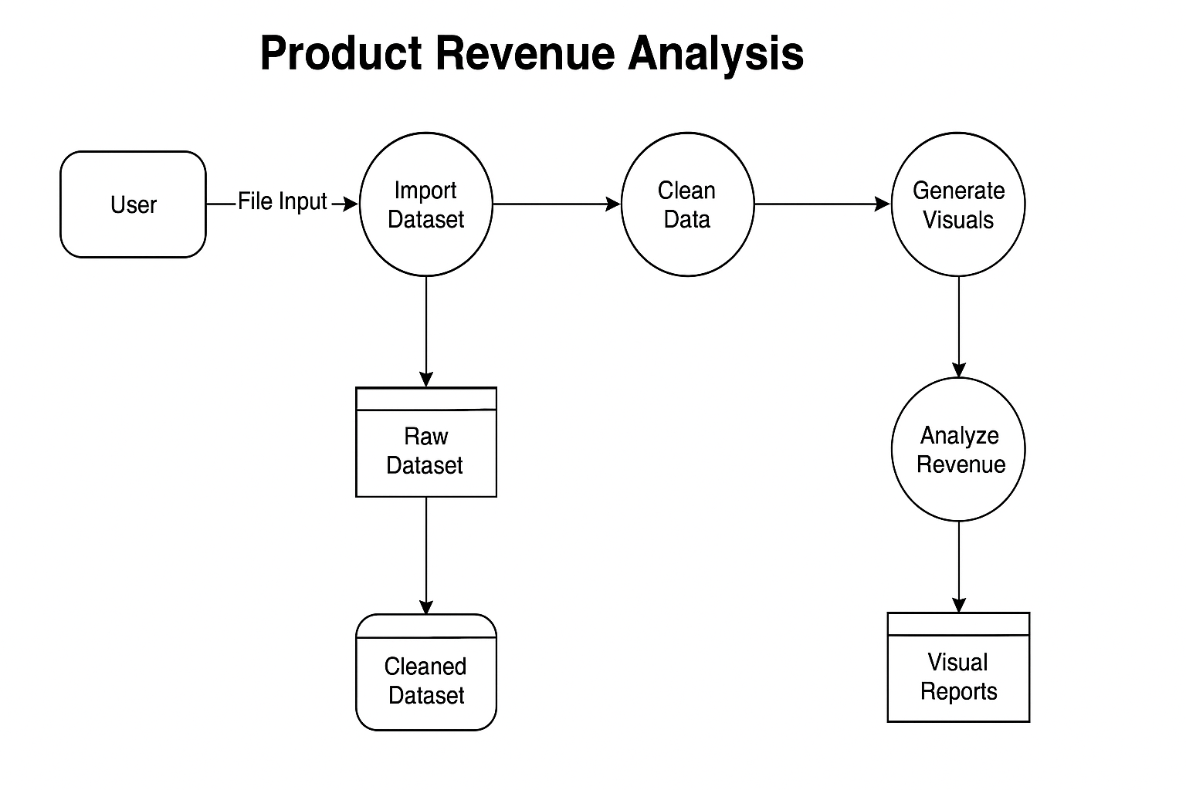
Data Flow Diagram

Slide 12

Screenshots

Slide 13

Conclusion
This project demonstrates how Python-based data science tools can be used effectively for analyzing and visualizing product revenue trends in e-commerce. By combining data processing with Pandas and NumPy, visual storytelling through Matplotlib and Seaborn, and interactive dashboard creation using Streamlit, the project offers actionable insights into sales performance. The modular and scalable design ensures the application can be enhanced further with real-time data feeds, forecasting models, or customer-level analytics. Overall, this solution lays a strong foundation for data-driven decision-making in the retail and e-commerce domain.
.

Slide 14

Future Scope
To expand the scope of this project, future developments could include the integration of real-time data pipelines for live sales tracking, implementation of machine learning models for sales forecasting, and building recommendation engines based on customer behavior. Enhancing the dashboard with filters, geographic mapping, and advanced interactivity using libraries like Plotly or Folium can provide deeper insights. Deployment on cloud platforms like Streamlit Cloud or Heroku would allow stakeholders to access the analysis remotely, making it a full-stack data science solution.

Slide 15
REFERENCE
1) https://www.w3schools.com/
2) https://www.javatpoint.com/

Slide 16
THANK YOU!

